Slide 1


Object Oriented Programming
Software Engineering Department
School of Information & Communication Technology
Hanoi University of Science and Technology
Chapter 05. Aggregation and Inheritance
Cao Tuấn Dũng
dungct@soict.hust.edu.vn
Notes:
Một trong những tiện ích của các ngôn ngữ lập trình cần phải có là khả năng tái sử dụng mã. Trong LTHDT khả năng tái sử dụng thể hiện ở hai cách
Cách thứ nhất là ta tạo các đối tượng của các lớp có sẵn trong lớp mới, như vậy lớp mới là sự kết tập giữa lớp mới định nghĩa với các lớp cũ đã có.
Cách thứ hai, ta sẽ tạo lớp mới là một phát triển của lớp có sẵn. Trong lớp mới sẽ sử dụng lại tính năng đã có trong lớp cũ và phát triển những tính chất mới.
Đó chính là bài học của chúng ta ngày hôm nay. Kế thừa.

Slide 2
Lesson Goals
Explaining concepts of source code re-usability
Showing the nature, description of concepts relating to aggregation and inheritance
Comparison of aggregation and inheritance
Representing aggregation and inheritance in UML
Explaining principles of inheritance and initialization order, object destruction in inheritance
Applying techniques, principles of aggregation and inheritance in Java programming language

Slide 3
Outline
Source code re-usability
Aggregation
Inheritance

Slide 4

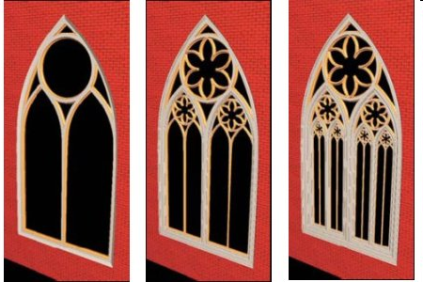
1. Re-usability
Source code re-usability: re-use already existing source code
  Structure programming: Re-use function/sub-program
  OOP: When modeling real world, there exist many object types that have similar or related attributes and behaviors
  → How to re-use already-written classes?

Slide 5
1. Re-usability (2)
How to use existing classes:
  Copying existing classes → Redundant and difficult to manage if any changes
  Creating new classes that are aggregation or re-usability of objects of existing classes → Aggregation
  Creating new classes based on the extension of existing classes → Inheritance

Slide 6

1. Re-usability (2)
Advantages
  Reducing man-power, cost.
  Improving software quality
  Improving modeling capacity of the real world
  Improving maintainability

Slide 7
Outline
Source code re-usability
Aggregation
Inheritance

Slide 8
2. Aggregation
Example:
  Point
    A quadrangle consists of 4 points
    → Aggregation
Aggregation
  Has-a or is-a-part-of relations

Slide 9
2.1. Nature of aggregation
Aggregate
  Members of a new class are objects of existing classes.
  Aggregation re-uses via objects
New class
  Aggregate/Whole class,
Existing class
  Member class (Part).

Slide 10
2.1. Nature of aggregation (2)
The whole class contains objects of member classes
  Is-a-part of the whole class
  Re-use data and behavior of member classes via member objects

Slide 11
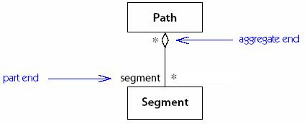
2.2. Representing aggregation in UML
Using “diamond” at the head of whole class
Using multiplicity at two heads:
  A positive integer: 1, 2,...
  A range (0..1, 2..4)
  *: Any number
  None: By default is 1
Quadrangle
Point
1
4

Slide 12
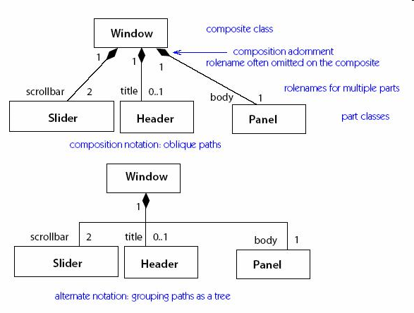
Example

Slide 13
2.3. Illustration in Java
class Point {
private int x, y;
public Point(){}
public Point(int x, int y) {
this.x = x; this.y = y;
}
public void setX(int x){ this.x = x; }
public int getX() { return x; }
public void hienThiPoint(){
System.out.print("(" + x + ", "
+ y + ")");
}
}

Slide 14
class Quadrangle {
private Point d1, d2;
private Point d3, d4;
public Quadrangle(Point p1, Point p2,
Point p3, Point p4){
d1 = p1; d2 = p2; d3 = p3; d4 = p4;
}
public Quadrangle(){
d1 = new Point(); d2 = new Point(0,1);
d3 = new Point (1,1); d4 = new Point (1,0);
}
public void printQuadrangle(){
d1.printPoint(); d2.printPoint();
d3.printPoint(); d4.printPoint();
System.out.println();
}
}
Quadrangle
Point
1
4

Slide 15
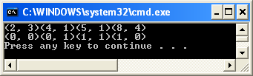
public class Test {
public static void main(String arg[])
{
Point d1 = new Point(2,3);
Point d2 = new Point(4,1);
Point d3 = new Point (5,1);
Point d4 = new Point (8,4);
Quadrangle tg1 = new Quadrangle(d1, d2, d3, d4);
Quadrangle tg2 = new Quadrangle();
tg1.printQuadrangle();
tg2.printQuadrangle();
}
}

Slide 16
Example 2
class Person {
private String name;
private Date bithday;
public String getName() { return name; }
...
}
class Employee {
private Person me;
private double salary;
public String getName() {
return me.getName();
}
...
}

Slide 17
Example 2
class Manager {
private Employee me;
private Employee assistant;
public setAssistant(Employee e) {...}
...
}
...
Manager junior = new Manager();
Manager senior = new Manager();
senior.setAssistant(junior); //error

Slide 18
An example of Aggregation
A game consisting of two players, 3 dies and an artitrator.
Need 4 classes:
  Player
  Die
  Arbitrator
  Game
→ Game class is the aggregation of the 3 remaining classes

Slide 19
Game
Die
…
3
- value : int
…
+ throw()
Player
Arbitrator
- name : String
- points : int
- name : String
2
+ countingPoints()
+ throwDie()
class Game
{
Die die1, die2, die3;
Player player1, player2;
Arbitrator arbitrator1;
...
}

Slide 20
Initialization order in aggregation
When an object is created, the attributes of that object must be initialized and assigned corresponding values.
Member attributes must be initialized first
→ Construction methods of member classes must be called first

Slide 21
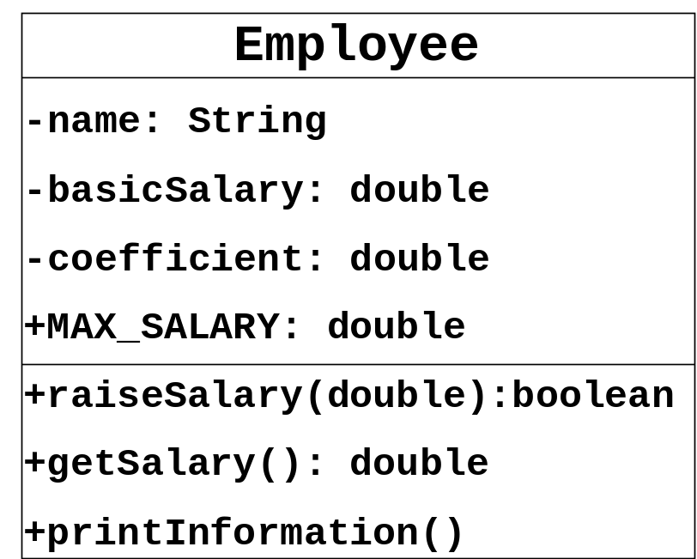
Exercise
Department
-name:String
-nEmployees:byte
+MAX_EMP_NUM:byte
+addEmployee(Employee):boolean
+removeEmployee(Employee):boolean
+getTotalSalary():double
+printInformation()
1 1..*
Write class Department described in above UML diagram with parameterized constructor, knowing that:
  Value of MAX_EMP_NUM is 100
  Employee adding and removing is perfomed using stack
  getTotalSalary() calculate total salary of all employees of this department.
  printInformation() display information about department and all employees.

Slide 22
public class Department {
private String name; private byte nEmployees;
public static final MAX_EMP_NUM = 100;
private Employee[] employeeList;
public boolean addEmployee(Employee e){
if (nEmployees < MAX_EMP_NUM) {
employeeList[nEmployees] = e; nEmployees++;
return true;
} else return false;
}
public boolean removeEmployee(Employee e){
if (nEmployees > 0) {
Employee tmp = employeeList[nEmployees -1];
employeeList[soNhanVien-1] = null; nEmployees --;
return true; ///employeeList[nEmployees];
} else return false;
}

Slide 23
// (cont.)
public Department(String name){
employeeList = new Employee[MAX_EMP_NUM];
this.name = name; nEmployees = 0;
}
public double getTotalSalary(){
double total = 0.0;
for (int i=0;i<nEmployees;i++)
total += employeeList[i].getSalary();
return total;
}
public void printInformation(){
System.out.println(“Name of Dept: "+name);
System.out.println(“Number of employees: “ + nEmployees);
System.out.println(“Employees info:");
for (int i=0;i<soNhanVien;i++)
employeeList[i].printInformation();
}
}

Slide 24
Discussion
In above example
What is Existing class? New class?
  Existing class: Employee
  New class: Department
New class re-uses existing classes via?
  Array of objects of class Employee
What does new class re-use from existing classes?
  getSalary () in method getTotalSalary()
  printInformation() in method printInformation()

Slide 25
Outline
Source code re-usability
Aggregation
Inheritance

Slide 26
3. Overview of Inheritance
Example:
  Point
    A quadrangle has 4 points
    Aggregation
  Quadrangle
    Square
    → Inheritance
Notes:
Một trong những tiện ích của các ngôn ngữ lập trình cần phải có là khả năng tái sử dụng mã. Trong LTHDT khả năng tái sử dụng thể hiện ở hai cách
Cách thứ nhất là ta tạo các đối tượng của các lớp có sẵn trong lớp mới, như vậy lớp mới là sự kết tập giữa lớp mới định nghĩa với các lớp cũ đã có.
Cách thứ hai, ta sẽ tạo lớp mới là một phát triển của lớp có sẵn. Trong lớp mới sẽ sử dụng lại code đã có trong lớp cũ và phát triển những tính chất mới. Cách này gọi là kế thừa.

Slide 27
3.1.1. The Nature of Inheritance
Inherit, Derive
  Creating new class by extending existing classes.
  New class inherits what are in existing classes and can have its own new features.
Existing class:
  Parent, superclass, base class
New class:
  Child, subclass, derived class
Notes:
Lớp cũ → Lớp cha hay lớp cơ sở
Parent, superclass hay base class
Lớp mới → Lớp con hay lớp dẫn xuất
Child, subclass hay derived class

Slide 28
Inheritance
Principles to describe a class based on the extension/concretization of an existing class or a set of existing classes (in case of multi-inheritance)
On modularity view: If B inherits A, all services of A will be available in B
On "typing" view: If B inherits A, at anytime if a instance of A is required, the instance of B might be a response.

Slide 29
Inheritance
Inheritance specifies a relationship between classes when a class shares It structure and/or behavior of a class or of other classes.
1 genealogy tree of the classes is created in which a subclass inherits from one or many superclasses
Inheritance is also called is-a relation.

Slide 30
3.1.1. The Nature of Inheritance (2)
Child class
  Is is-a-kind-of) of parent class
  Re-uses by inheriting data and behavior of parent classes
  Concretizes in order to adapt to new usage targets
    Extension: Add more new attributes/behavior
    Redefinition (Method Overriding): Modify the behavior inheriting from parent class

Slide 31
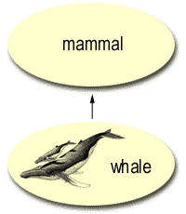
Similarity
Whale class inherits from mammal class.
A whale is-a mammal )
Whale class is subclass, mammal class is superclass
Mammal Class
Whale Class
Horse Class

Slide 32
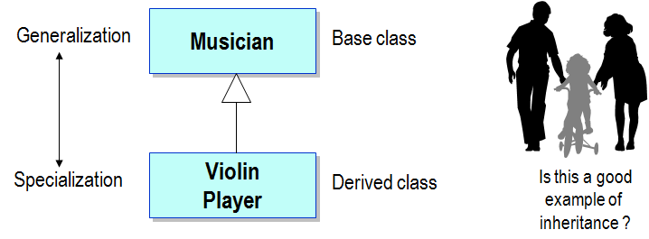
Inheritance
Inheritance specifies an “is a kind of" relationship
  Inheritance is a class relationship
  New classes specialize existing classes

Slide 33
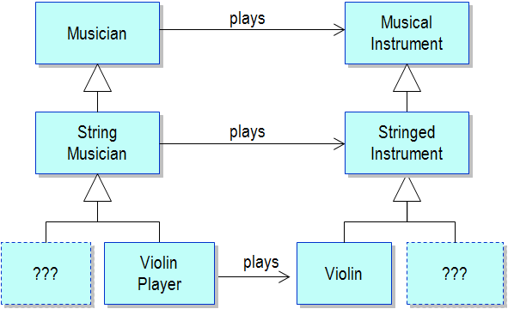
Class Hierarchies
Classes related by inheritance form class hierarchies

Slide 34
Inheritance
Both Whale and Horse has is-a relation with mammal class
Both Whale Horse have some common behaviors of Mammal
Inheritance is a key to re-use source code – If a parent class is created, the child class can be created and can add some more information

Slide 35
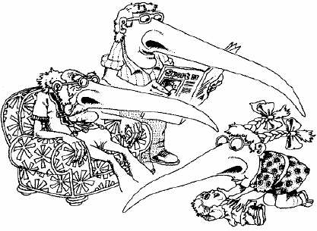

Slide 36
3.1.2. Aggregation and Inheritance
Comparing aggregation and inheritance?
  Similarity
    Both are techniques in OOP in order to re-use source code
  Difference?

Slide 37
Distinguish aggregation and inheritance
Inheritance Aggregation
Inheritance re-uses via class.
  Creating new class by extending exisiting classes
“is a kind of” relation
Example: Car is a kind of transportation mean
Aggregation re-uses via objects.
  Create a reference to objects of existing classes in the new class
“is a part of” relation
Example: Car has 4 wheels

Slide 38
3.1.3. Representing Inheritance in UML
Using “empty triangle” at parent class
Quadrangle
Hinh
Vuong
Hinh
Thang

Slide 39
3.1.4. Inheritance hierarchy
A
B
Is hierarchy tree struture, representing inheritance relation between classes.
Direct inheritance
  B is direct inheritance from A
Indirect inheritance
  C is indirect inheritance from A
Vehicle
C
Car
Moto
SportMoto
SportCar
Compact

Slide 40
3.1.4. Inheritance hierarchy (2)
Child classes having the same parent class are called siblings
Classes that inherit will be inherited by the classes in lower level in the hierachy tree → A child class inherits all its deccesors.
Hình
Hình hai chiều
Hình ba chiều
Hình tròn
Tứ giác
Tam giác
Hình cầu
Hình lăng trụ
Tứ diện

Slide 41
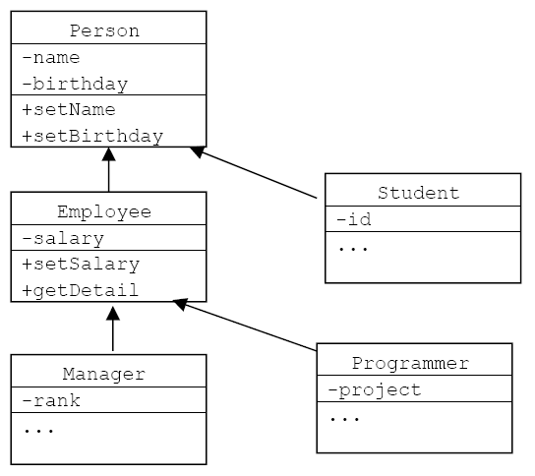
3.1.4. Hierarchy tree (2)
All objects inherit
from the basic
class Object

Slide 42
Class Object
Class Object is defined in the standard package java.lang
If a class is not defined as a child of another class, it is by default a direct child of class Object.
→ Class Object is the root class on the top level in the hierarchy tree
Notes:
Notes:
Purpose — Provide an overview of OOP Concepts.
Details —
Additional Information —
Transition Statement —

Slide 43
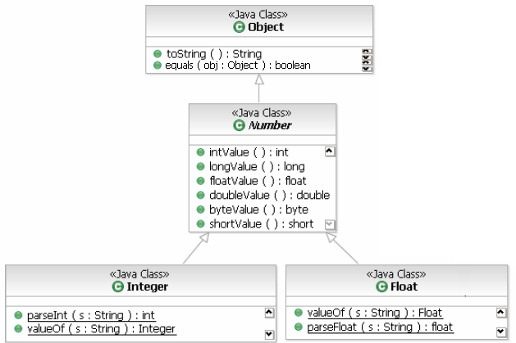
Class Object (2)
Contains some useful methods that are inherited by all other classes, for example: toString(), equals()...
Notes:
Notes:
Purpose — Provide an overview of OOP Concepts.
Details —
Additional Information —
Transition Statement —

Slide 44
3.2. Inheritance rules
Access attribute: protected
Protected member in a parent class is accessed by:
  Members of parent classes
  Members of children classes
  Members of classes in the same package as the parent class
What does a child class inherit?
  Inherit all the attributes/methods that are declared as public and protected in the parent class.
  Does not inherit private attributes/methods.

Slide 45
3.2. Inheritance rules (2)
 | public | None | protected | private
Same class
Child classes – same package
Child classes – different package
Different package, non-inher

Slide 46
3.2. Inheritance rules (2)
 | public | None | protected | private
Same class | Yes | Yes | Yes | Yes
Child classes – same package | Yes | Yes | Yes | No
Child classes – different package | Yes | No | Yes | No
Different package, non-inher | Yes | No | No | No

Slide 47
3.2. Inheritance rules (3)
Methods that can not be inherited:
  Construction and destruction methods
    Methods that initialize and delete objects
    These methods are only defined to work in a specific class
  Assignment operation =
    Performs the same task as construction method

Slide 48
3.3. Inheritance syntax in Java
Inheritance syntax in Java:
  <Child Class> extends <Parent Class>
Example:
  class Square extends Quadrangle {
  ...
  }
  class Bird extends Animal {
  ...
  }

Slide 49
Example 1.1
public class Quadrangle {
protected Point d1, d2, d3, d4;
public void setD1(Point _d1) {d1=_d1;}
public Point getD1(){return d1;}
public void printQuadrangle(){...}
…
}
public class Square extends Quadrangle {
public Square(){
d1 = new Point(0,0); d2 = new Point(0,1);
d3 = new Point(1,0); d4 = new Point(1,1);
}
}
public class Test{
public static void main(String args[]){
Square hv = new Square();
hv.printQuadrangle();
}
}
Using protected attributes of the parent class in the child class
Calling public method of parent class

Slide 50
Example 1.2
public class Quadrangle {
protected Point d1, d2, d3, d4;
public void printQuadrangle(){...}
public Quadrangle(){...}
public Quadrangle(Point d1, Point d2,
Point d3, Point d4) { ...}
}
public class Square extends Quadrangle {
public Square(){ super(); }
public Square(Point d1, Point d2,
Point d3, Point d4){
super(d1, d2, d3, d4);
}
}
public class Test{
public static void main(String args[]){
Square hv = new Square();
hv.printQuadrangle();
}
}

Slide 51
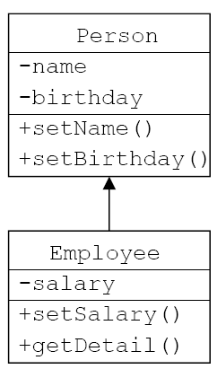
Example 2
protected
class Person {
private String name;
private Date bithday;
public String getName() {return name;}
...
}
class Employee extends Person {
private double salary;
public boolean setSalary(double sal){
salary = sal;
return true;
}
public String getDetail(){
String s = name+", "+birthday+", "+salary;//Loi
}
}

Slide 52
Example 2 (cont.)
public class Test{
public static void main(String args[]){
Employee e = new Employee();
e.setName("John");
e.setSalary(3.0);
}
}

Slide 53
Example 3 – Same package
public class Person {
Date birthday;
String name;
...
}
public class Employee extends Person {
...
public String getDetail() {
String s;
String s = name + "," + birthday;
s += ",“ + salary;
return s;
}
}

Slide 54
Example 3 – Different package
package abc;
public class Person {
protected Date birthday;
protected String name;
...
}
import abc.Person;
public class Employee extends Person {
...
public String getDetail() {
String s;
s = name + "," + birthday + "," + salary;
return s;
}
}

Slide 55
Construction and destruction of objects in inheritance
Object construction:
  A parent class is initialized before its child classes.
  Construction methods of a child class always call construction methods of its parent class at the very first command
    Implicit call: whe the parent class has a default constructor
    Explicit call (explicit)
Object destruction:
  Contrary to object initialization
Notes:
Khi một đối tượng được tạo mới, chương trình dịch đảm bảo rằng tất cả các thuộc tính của nó đều phải được khởi tạo và gán những giá trị tương ứng.
Vậy, khi khởi tạo một đối tượng thuộc một lớp kế thừa, chúng sẽ được khởi tạo như thế nào và theo thứ tự nào?
Dung o đây.

Slide 56
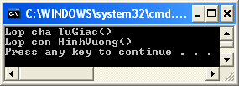
3.4.1. Implicit call of constructor of parent class
public class Quadrangle {
protected Point d1, d2;
protected Point d3, d4;
public Quadrangle(){
System.out.println
("Lop cha Quadrangle()");
}
//…
}
public class Square
extends Quadrangle {
public Square(){
//Tu dong goi Quadrangle()
System.out.println
("Lop con Square()");
}
}
public class Test {
public static void main(String arg[])
{
Square hv =
new Square();
}
}

Slide 57
3.4.2. Implicit constructor call of parent class
The first command in constructor of a child class can call the construtor of its parent class
  super(arguments_list);
  This is obliged if the parent class does not have any default constructor
    Parent class already has a constructor with arguments
    The constructor of child class must not have arguments.

Slide 58
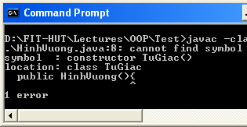
Example
public class Test {
public static void main(String arg[])
{
Square hv = new
Square();
}
}
public class Quadrangle {
protected Point d1, d2;
protected Point d3, d4;
public Quadrangle(Point d1,
Point d2, Point d3, Point d4){
System.out.println("Lop cha
Quadrangle(d1, d2, d3, d4)");
this.d1 = d1; this.d2 = d2;
this.d3 = d3; this.d4 = d4;
}
}
public class Square extends Quadrangle {
public Square(){
System.out.println
("Lop con Square()");
}
}
Lỗi

Slide 59
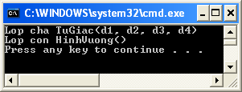
Explicit constructor call of parent class
Constructor of child class has no arguments
. . .
Square hv = new Square();
public class Quadrangle {
protected Point d1,d2,d3,d4;
public Quadrangle(Point d1, Point d2,
Point d3, Point d4){
System.out.println("Lop cha
Quadrangle(d1, d2, d3, d4)");
this.d1 = d1; this.d2 = d2;
this.d3 = d3; this.d4 = d4;
}
}
public class Square extends Quadrangle {
public Square(){
super(new Point(0,0), new Point(0,1),
new Point(1,1),new Point(1,0));
System.out.println("Lop con Square()");
}
}

Slide 60
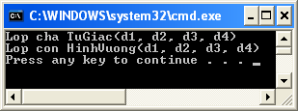
Explicit constructor call of parent class
Constructor of child class has arguments
public class Quadrangle {
protected Point d1,d2,d3,d4;
public Quadrangle(Point d1,
Point d2, Point d3, Point d4){
System.out.println
("Lop cha Quadrangle(d1,d2,d3,d4)");
this.d1 = d1; this.d2 = d2;
this.d3 = d3; this.d4 = d4;
}
}
public class Square extends Quadrangle {
public Square(Point d1, Point d2,
Point d3, Point d4){
super(d1, d2, d3, d4);
System.out.println("Lop con Square(d1,d2,d3,d4)");
}
}
. . .
Square hv =
new Square(
new Point(0,0),
new Point(0,1),
new Point(1,1),
new Point(1,0));

Slide 61
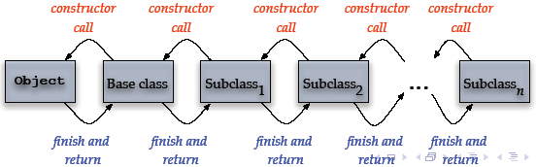
Implicit call of constructor
When initializing an object, a serie of constructors will be called explicitly (via super() method call or implicitly)
Constructor call of the most basic class in the hierarchy tree will be done last, but will finish first. The constructor of the derived class will finish at the last.
Notes:
Dung CQ o day

Slide 62
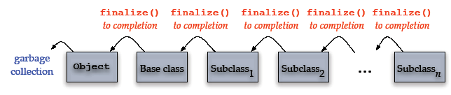
Implicit call of finalize()
When an object is destroyed (by GC), a serie of finalize() methods will be called automatically.
The order is inverse compared to the calls of constructors
  Method finalize() of derived class is called first, then the ones of its parent class

Slide 63
Inheritance characteristics in C++
Notes:
Cau hoi: Thi. Thuoc tinh dong goi thay doi nhu the nao doi voi Java (So sanh voi C++)

Slide 64
Inheritance declaration
class DerivedClass : access-specifier BaseClass
{
// Body of the derived class
};
DerivedClass
BaseClass
Access-specifier: public, protected, private

Slide 65
Inheritance declaration
  Suppose that there are two classes A and B; to build class C derived from A and B, we do as follows:
  class C : public A, public B
  {
  private:
  // khai báo các thuộc tính
  public:
  // các phương thức
  };

Slide 66
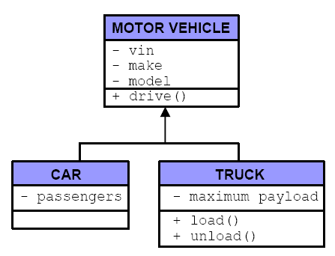
Example: MotorVehicle

Slide 67
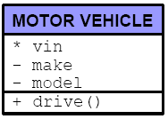
Example: MotorVehicle
Starting by defining a basic class, MotorVehicle
class MotorVehicle {
public:
  MotorVehicle(int vin, string make, string model);
  ~MotorVehicle();
  void drive(int speed, int distance);
private:
  int vin;
  string make;
  string model;
};

Slide 68
Example: MotorVehicle
Then, define constructor, destructor, and function drive() (here, we temporarily define drive())
MotorVehicle::MotorVehicle(int vin, string make, string model)
{
  this->vin = vin;
  this->make = make;
  this->model = model;
}
MotorVehicle::~MotorVehicle() {}
void MotorVehicle::drive(int speed, int distance)
{
cout << “Dummy drive() of MotorVehicle.” << endl;
}

Slide 69
Declaration of child classes
The declaration of a child class is similar to its representation in object relational diagram, we focus only on the difference compared to its parent classes
Advantages
  Simplify class declaration,
  Support encapsulation principles of OOP
  Support code re-usability (re-use the definitions of attributes and functions)
  Hiding information can play an important role in creating inheritance tree

Slide 70
Definition of child class Car
Showing the relation between the child class Car and its parent class MotorVehicle
class Car : public MotorVehicle
{
public:
    Car (int passengers);
    ~Car();
private:
int passengers;
};

Slide 71
Class Car
Convention: all arguments of the parent class are located at the head of the list.
class Car : public MotorVehicle
{
public:
  Car (int vin, string make, string model, int passengers);
  ~Car();
private:
int passengers;
};
Car::Car(int vin, string make, string model, int passengers)
{
  this->vin = vin;
  this->make = make;
  this->model = model;
  this->passengers = passengers;
}
Car::~Car() {}

Slide 72
Definition of child class
Disadvantages: access directly data of basis classes
  Missing encapsulation: have to know well about basic classes
  Do not re-use constructor code of basic classes
  Can not initialize private members of basic classes because of missing access permission
Rule: an object of a child class consists of an object of its parent class and complement features of the child class
  A representation of the basic class will be created first, then it will "add" the complement features of the derived class
Hence, we will use constructor of the basic class.

Slide 73
Definition of child class
To use constructor of a basic class, we use initialization list of constructor (similarly to the initialization of constant members)
  The only way to create the part belonging to the representation of the parent class that is created first
Car::Car(int vin, string make, string model, int passengers)
: MotorVehicle(vin, make, model)
{
this->passengers = passengers;
}
Calling constructor of MotorVehicle with arguments vin, make, model
We do not need to initialize vin, make, model from inside constructor of Car anymore

Slide 74
Definition of child class
To ensure that a representation of the basis class is always created first, if we skip constructor call of the basic class at the initialization of the derived class, the compiler will automatically insert the default constructor of the basic class
Although we need to call explicitly constructor of the basic class, at the destructor of the derived class, the similar call for destructor of the basic class is not neccessary
  this is done automatically

Slide 75
Definition of child class
Tương tự chúng ta có định nghĩa lớp Truck như sau
class Truck : public MotorVehicle {
public:
  Truck (int vin, string make, string model,
  int maxPayload);
  ~Truck();
  void Load();
  void Unload();
private:
int maxPayload;
};
Truck::Truck(int vin, string make, string model,
int maxPayload)
: MotorVehicle(vin, make, model)
{
this->maxPayload = maxPayload;
}
Truck::~Truck() {}
void Truck::Load() {…}
void Truck::Unload() {…}

Slide 76
Access to inheritance members
The access to inheritance members depends not only on how they are declared (with keywords public, protected or private) in base class.
Access also depends on the inheritance type - public, protected or private – Inheritance type defined in the definition of derived class.

Slide 77
Public inheritance
Public inheritance means:
  public members of base class become public members của derived class;
  protected members of base class become protected members of derived class;
  private members of base class can not be accessed in derived class.

Slide 78
Example
Building Class
- rooms: int
- floors: int
Suppuse there are two following inheritance classes
House Class
- bedrooms: int
- bathrooms: int

Slide 79
class Building
{
public:
void setRooms(int numRooms);
int getRooms() const;
void setFloors(int numFloors);
int getFloors() const;
private: // ??
int rooms; // Number of rooms
int floors; // Number of floors
};
class House : public Building
{
public:
void setBedrooms(int numBedrooms);
int getBedrooms() const;
void setBathrooms(int numBathrooms);
int getBathrooms() const;
private:
int bedrooms; // Number of bedrooms
int bathrooms; // Number of bathrooms
};
Can not access from
derived class => chuyển thành :
protected

Slide 80
Class MotorVehicle and Truck
class MotorVehicle {
...
private:
  int vin;
  string make;
  string model;
};
Return to the inheritance tree with MotorVehicle that is the basic class
  All data members are declared as private, hence they are only accessed from instances of MotorVehicle
  All the derived classes have no permission to access private members of MotorVehicle
Hence, the following code
is not correct
void Truck::Load() {
if (this->make == “Ford”) {
...
}
}

Slide 81
Class MotorVehicle and Truck
class MotorVehicle {
...
protected:
  int vin;
  string make;
  string model;
};
Suppose we want child classes of MotorVehicle to be able to access its data
Replace the keyword private by protected,
The following code will not give error anymore
void Truck::Load() {
if (this->make == “Ford”) {
...
}
}

Slide 82
Protected inheritance
  public members of base class become protected members of derived class;
  protected members of base class become protected members of derived class;
  private members of base class can not be accessed in derived class.
  Inheritance relation will be seen from
    All methods in Car,
    All methods of child classes of Car
  However, all other objects of C++ will not see this relation

Slide 83
Private inheritance
  public members of base class become private members of derived class;
  protected members of base class become private of derived class;
  private members of base class can not be accessed in derived class.
  only its representation knows that it is inherited from its parent classes
  External objects can not interact with the child class as with the parent class, because all the inheritance members become private in the child class
  We can use private inheritance to create a child class that have all the features of the parent class without being known from outside.

